Slide 1
SPECIFYING PROCESSES

Slide 2
PROBLEMS WITH DFDs
HERE IS A DFD
CUSTOMER
ORDER
PROCESS ORDER
QUESTION
WHAT DOES AN ORDER CONSIST OF?
HOW EXACTLY IS IT PROCESSED?
CANNOT TELL FROM THE DFD
WE NEED OTHER TOOLS

Slide 3
SPECIFYING PROCESSES
We need to specify exactly what is done by a process so that:-
  We can describe it to the end users for their comments
  We can write a specification for a programmer so that he/she will write a program to do exactly what is required.

Slide 4
SUPPORT TOOLS
Structured English
Decision Trees
Decision Tables
Data Dictionaries
Entity Relationship Diagrams

Slide 5
PROCESS ORDER
CUSTOMER
ORDER
COPIES OF ORDERS
DESCRIBED IN
DESCRIBED IN
ORDER FILE
DATA DICTIONARY
DESCRIBED BY
DECISION TABLES,
STRUCTURED
ENGLISH ETC
STORED IN

Slide 6
WHY NOT TEXT / NATURAL LANGUAGE?
We need to describe and specify processes
Natural language is not suitable.
Too vague
Too rich
Too open to
  Misunderstandings and
  Ambiguities
  Omissions
  Contradictions

Slide 7
EXAMPLE OF AMBIGUITIES
What does the following sentence mean?
  All customers who have more than £5000 in their account and who have an average monthly balance exceeding £500 or who have been customers for more than 5 years receive a discount

Slide 8
AMBIGUITIES
Does it mean?
  All customers (who have more than £5000 in their account AND an average monthly balance exceeding £500) OR who have been customers for more than 5 years receive a discount.
    Or does it mean?
  All customers who have more than £5000 in their account AND (an average monthly balance exceeding £500 OR who have been customers for more than 5 years) receive a discount.

Slide 9
AMBIGUITIES
In case (a)
  Customers who have been with the firm for more than 5 years receive a discount
In case (b)
  They do not.
This piece of text will cause confusion to staff and customers.

Slide 10
WHY STRUCTURED ENGLISH?
We need a less rich and varied language in which to describe processes.
This type of language is called 'Structured english’ Or sometimes ‘Tight english’
This is a language that uses a limited vocabulary and a limited syntax to describe and specify processes and policy.

Slide 11
WHAT IS STRUCTURED ENGLISH
LIKE
The vocabulary consists only of:
  Commands.
  Terms defined in the data dictionary.
  Special words for logical structures.
The syntax consists of only:
  Simple commands
  Decisions
  Repetition or loops
Combinations of the above

Slide 12
PRODUCING STRUCTURED ENGLISH
The text can be closer to natural English or closer to pseudocode.
Styles of structured English vary but producing it should always force the analyst to think clearly and logically about the process being described.
I f you find that you cannot write a structured English description of a process it means:
  Either
    You don't really understand the process
  Or
    You haven't broken the process down far enough.

Slide 13
PRODUCING STRUCTURED ENGLISH
The two building blocks of Structured English are:
  (1) structured logic or instructions organized into nested or grouped procedures, and
  (2) simple English statements such as add, multiply, move, etc. (strong, active, specific verbs)

Slide 14
Five conventions to follow when using structured English
Express all logic in terms of sequential structures, decision structures, or iterations.
Use and capitalize accepted keywords such as: IF, THEN, ELSE, DO, DO WHILE, DO UNTIL, PERFORM
Indent blocks of statements to show their hierarchy (nesting) clearly.
When words or phrases have been defined in the Data Dictionary, underline those words or phrases to indicate that they have a specialized, reserved meaning.
Be careful when using "and" and "or" as well as "greater than" and "greater than or equal to" and other logical comparisons.

Slide 15
A BUSINESS PROCEDURE
An insurance company calculates car insurance renewals as follows:
If someone has had a claim in the last year and they are over 25 then £100 is added to their premium, if they are under 25 then £200 is added to their premium.
If they have not had a claim in the last year and they are over 25 then £10 is added to their premium, if they are under 25 then £25 is added to their premium.

Slide 16
EXAMPLE OF STRUCTURED ENGLISH.
FOR EACH RENEWAL
IF AGE < 25
IF CLAIM IN LAST YEAR
ADD £200 TO PREMIUM
ELSE NO CLAIM IN LAST YEAR
ADD £ 25 TO PREMIUM
IF AGE >= 25
IF CLAIM IN LAST YEAR
ADD £100 TO PREMIUM .
ELSE NO CLAIM IN LAST YEAR
ADD £10 TO PREMIUM
NEXT RENEWAL

Slide 17
ALTERNATIVE FORMAT
FOR EACH RENEWAL
IF AGE< 25
IF CLAIM IN LAST YEAR
ADD £200 TO PREMIUM
ELSE NO CLAIM IN LAST YEAR
ADD £ 25 TO PREMIUM
END-IF
END-IF
IF AGE >= 25
IF CLAIM IN LAST YEAR
ADD £100 TO PREMIUM
ELSE NO CLAIM IN LAST YEAR
ADD £ 10 TO PREMIUM
END-IF
END-IF
NEXT RENEWAL

Slide 18
DECISION TREES
Decision trees use a tree format to represent processes
Decision Trees are useful when the sequence of conditions and actions is critical or not every condition is relevant to every action.
They are useful for simple processes
With more complex processes they become large and unwieldy

Slide 19
DECISION TREES
Four major steps in building Decision Trees:
  Identify the conditions
  Identify the outcomes (condition alternatives) for each decision
  Identify the actions
  Identify the rules.

Slide 20
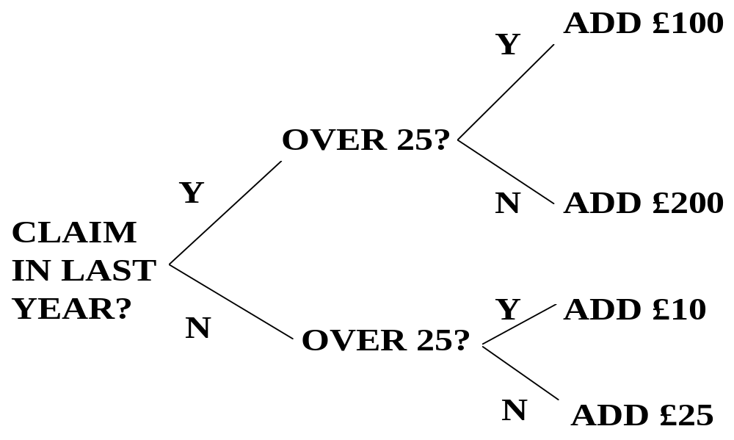
USING DECISION TREES

Slide 21
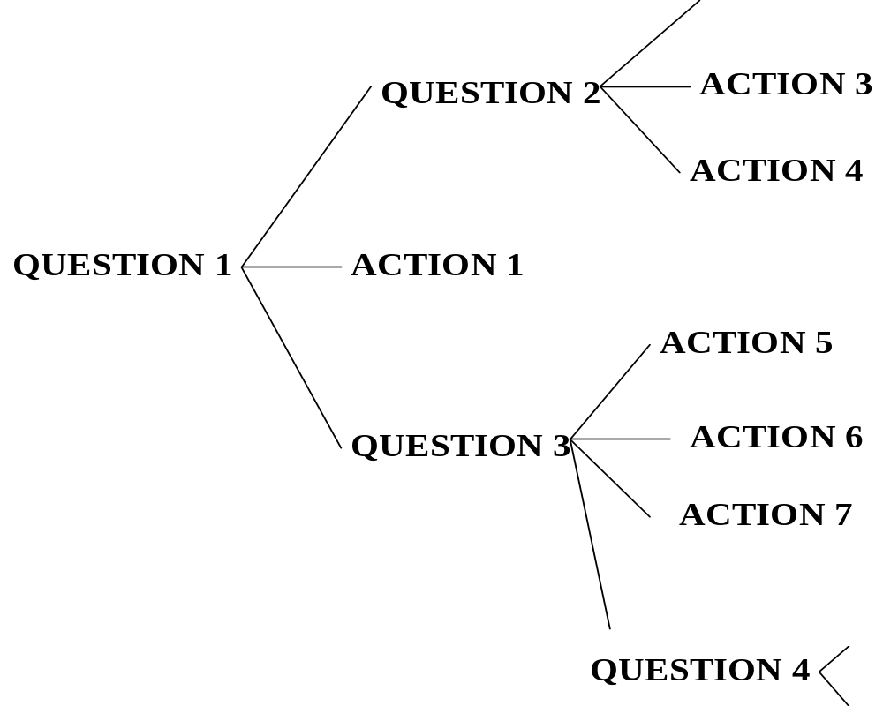
A COMPLEX DECISION TREE

Slide 22
DECISION TABLES
Decision tables contain a set of conditions which give rise to a set of actions covering all possible circumstances
They are useful when complex combinations of conditions, actions, and rules are found or you require a method that effectively avoids impossible situations, redundancies, and contradictions.

Slide 23
THE LAYOUT OF A DECISION TABLE
Condition stub:-
  What questions are we asking?
Action stub:-
  What actions are possible?
Condition entries:-
  All possible combinations of conditions, also called rules
Action entries:-
  What action is taken for each combination of conditions or rule?

Slide 24
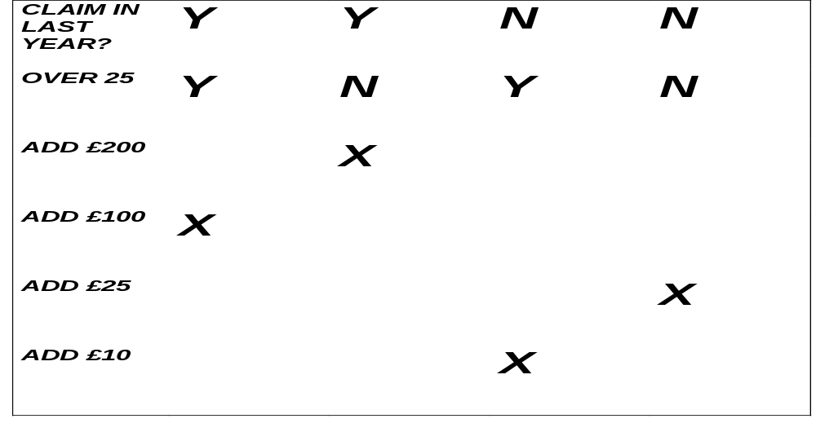
USING DECISION TABLES
A LIMITED ENTRY DECISION TABLE

Slide 25
USING DECISION TABLES
There is a simple formula for calculating the number of rules in a limited entry decision table
  R = 2^{c}
  Where r = the number of rules
  C = the number of conditions
  If c is greater that 4 we may need to consider using 2 or more tables

Slide 26
Decision Table example 2
No charges are reimbursed to the patient until the deductible has been met. After the deductible has been met, reimburse 50% for Doctor's Office visits or 80% for Hospital visits.
  There will be 4 rules. The first condition (Is the deductible met?) has two possible outcomes, yes or no. The second condition (type of visit) has two possible outcomes, Doctor's office visit (D) or Hospital visit (H). Two times two is four.

Slide 27
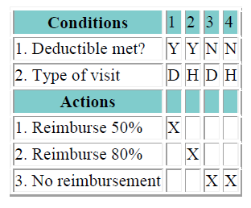
Example 2 solution

Slide 28
Decision Tables Example 3
No charges are reimbursed to the patient until the deductible has been met. After the deductible has been met, the amount to be reimbursed depends on whether or not the doctor or hospital is a "Preferred Provider." For preferred providers Doctor's office visits are reimbursed at 65% and Hospital visits are reimbursed at 95%. For other providers reimburse 50% for Doctor's Office visits or 80% for Hospital visits.
  There will be 8 rules. The first condition (Is the deductible met?) has two possible outcomes, yes or no. The second condition (Is it a Preferred Provider?) has two possible outcomes, yes or no. The third condition (type of visit) has two possible outcomes, Doctor's office visit (D) or Hospital visit (H). Two times two times two is 8.

Slide 29
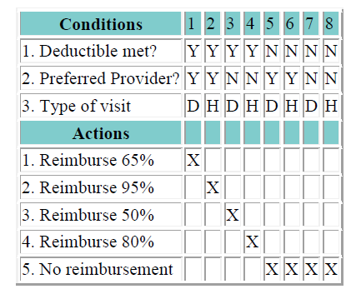
Decision Tables Example 3

Slide 30
Decision Tables Example 4
No charges are reimbursed to the patient until the deductible has been met. Doctor's office visits are reimbursed at 50%, Hospital visits are reimbursed at 80% and Lab visits are reimbursed at 70%.
  There will be 6 rules. The first condition (Is the deductible met?) has two possible outcomes, yes or no. The second condition (type of visit) has three possible outcomes, Doctor's office visit (D) or Hospital visit (H) or Lab visit (L). Two times three is 6.

Slide 31
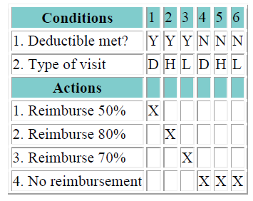
Decision Tables Example 4 solution

Slide 32
Decision Tables Example 5
No charges are reimbursed to the patient until the deductible has been met. Hospital visits are reimbursed at 80% and Lab visits are reimbursed at 70%. Doctor's office visits are reimbursed at 90% for "Participating Physicians" or 50% for others. The question of whether the Doctor is a Particpating Physician is only applicable for Doctor's office visits; it is not applicable for Hospital visits or Lab work.
  There will be 12 rules. The first condition (Is the deductible met?) has two possible outcomes, yes or no. The second condition (type of visit) has three possible outcomes, Doctor's office visit (D) or Hospital visit (H) or Lab visit (L). There are two possible outcomes to the question of whether in the case of a Doctor's Office visit the Doctor is a Participating Physician, yes or no. Two times three times two is 12.

Slide 33
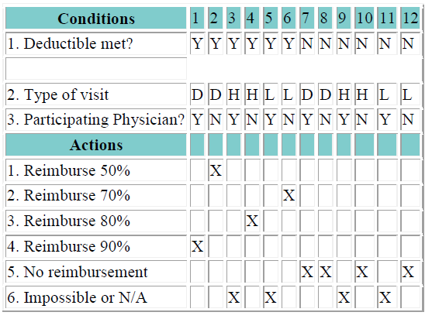
Decision Tables Example 5 Solution

Slide 34
Decision Tables Example 5 Solution cont.
Note that the "Y" under Participating Physican specifically means that this event for which the patient wants reimbursement was a Doctor's Office visit to a Participating Physician; "N" would then mean that it was not a Doctor's Office visit to a Participating Physician.
Notice that Hospital visits or Lab visits that are also marked Yes for Participating Physician are listed as Impossible. These conditions are mutually exclusive. By definition a Hospital visit cannot be a Doctor's Office visit to a Participating Physician. By definition a Lab visit cannot be a Doctor's Office visit to a Participating Physician.

Slide 35
Exercise
A flight to London costs $5,000 if the ticket is business class, and $3,000 if it is economy. However, if you stay in London for more than one week, the economy fare only costs $1,000.
i) Draw a decision table which represents these conditions and outcomes. Make sure your table is minimal with respect to the number of rows and columns used.
ii) Represent the above logic using structured English

